Slide 1
SYMBEXNET: Testing Network Protocol Implementations with Symbolic Execution and Rule-Based Specifications
JaeSeung Song TSE’14 July

Slide 2
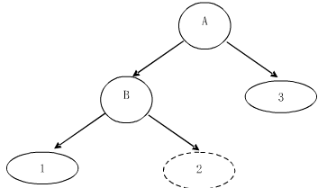
What is Symbolic Execution?
Auto Debuger
Use symbolic variables
Add constrains at a branch
Construct a tree
Record the error and ignore
Keep on running to find more
Terminate
According to the constrains se, generate a suitable concrete test input
Symbolic variables :
x = a
Meet Branch
Add constrain:
a < 10; a >= 10
Meet Error
Record and ignore
Terminate and generate test input

Slide 3
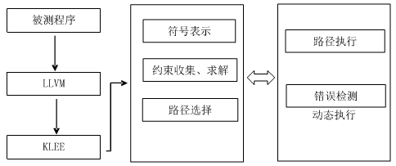
An SE Tool -- KLEE
A approved SE Tool
Expand coverage
Constrain solve
Tricks to reduce complexity
Constraint simplification
Counter-example cache
Path selection
Random path: avoid stuck
Opt path: lower the prior
Environment Model
Call model
Simple models for 40 syscalls
Symbolic variables
Meet Branch add state
Execute path
Environment model
Solve constraint
Record error & ignore
Select Path
Terminate and generate test input

Slide 4
SE-Tool based on KLEE
SymbexNet
Implementations of network protocols
SYMBEXNET: Testing Network Protocol Implementations with Symbolic Execution and Rule-Based Specifications
JaeSeung Song TSE’14 July
S²E
Large Scale Real System
S2E: A Platform for In-Vivo Multi-Path Analysis of Software Systems
Vitaly Chipounov SIGPLAN’11

Slide 5
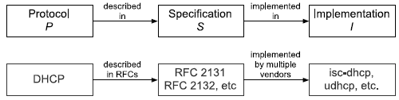
What’s the Problem?
Same protocol – Different implementations
Interoperability problems
Low-level language errors
Like stack overflow, divide zero …
Bugs after continuous packets input
Prolonged operation
Semantic errors:
Against the protocol rules
Complexity when state space is large
exponential explosion
Main Idea

Slide 6
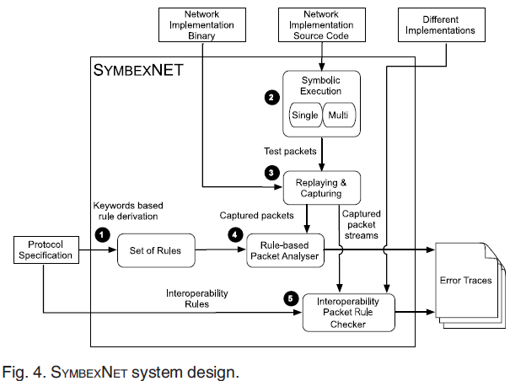
What does SymbexNet do?
Low-level error
Complexity : single-
Conti’ packets : Multi-
Rule Check
Single/Multi-SE
Rule extract & express
Interoperability

Slide 7
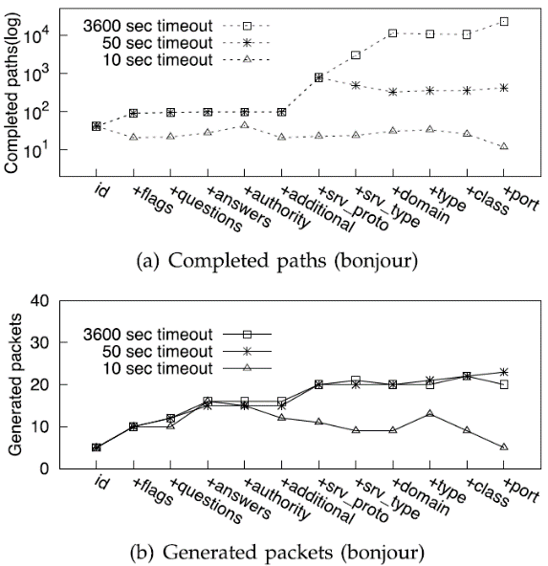
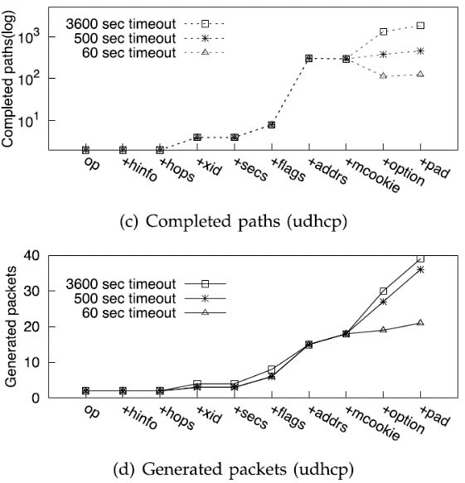
Single-packet exchange SE
Stateless Protocol
Packets processed individually
No interference
Select field and timeout
Timeout is the time slide for each input, return when time is out
Terminate
Record stream as test stream
Stream for rule check and interoperability check
Both client and server
Symbolic packet: fields
Run KLEE
Record stream
(client & server)

Slide 8
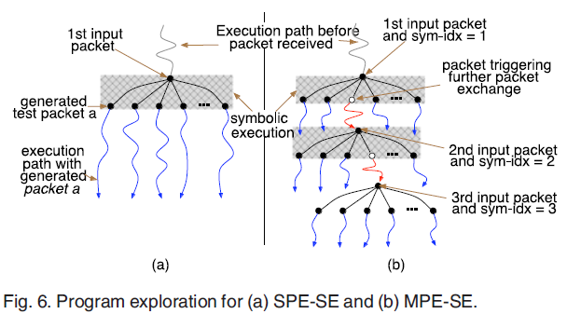
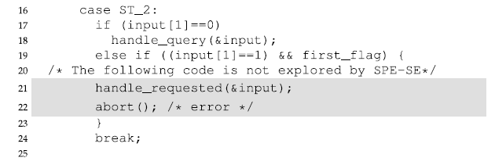
Multi-packets exchange SE
Result relay on pre-packets
Need continuous input
Progressive method
Run 1st input →single-
Give the concrete result of the SE
Run 2nd input based on each branch given by previous concrete result
…
Reduce complexity using concrete value.
Still exponent conplexity

Slide 9
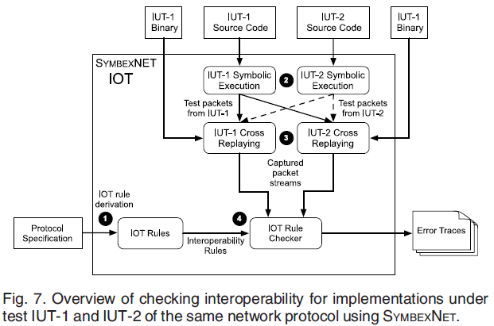
Rule Check & Interoperability Check
Rule Extraction
Use the specification (txt)
Keyword: SHOULD, MUST…
Rule Express Language
Packet stream language
Interoperability Check
Creation of IOT rules.
Generation of test packets.
Cross-replay of test packets.
Interoperability checking.

Slide 10
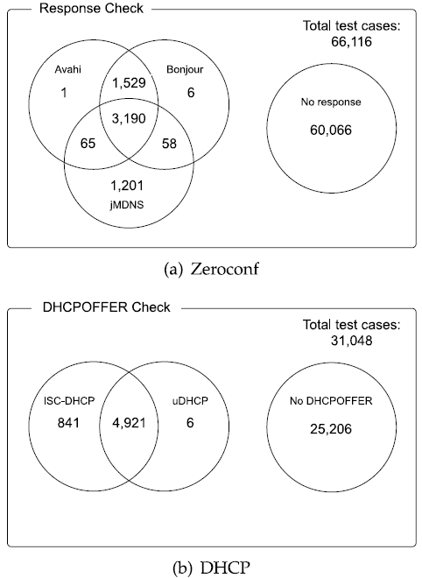
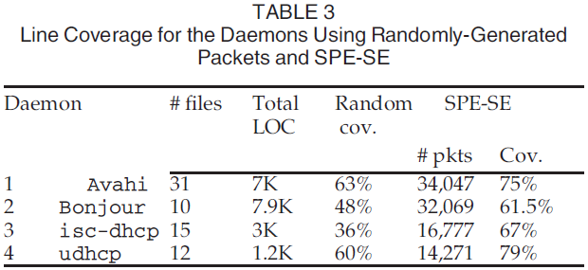
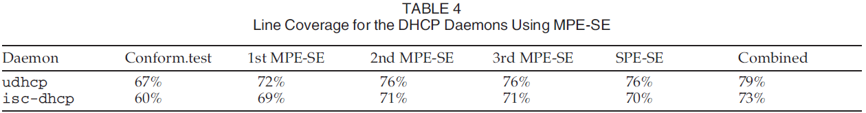
Evaluable – single/multi/inter-

Slide 11
Two SE-Tool based on KLEE
SymbexNet
Implementations of network protocols
SYMBEXNET: Testing Network Protocol Implementations with Symbolic Execution and Rule-Based Specifications
JaeSeung Song TSE’14 July
S²E
Large Scale Real System
S2E: A Platform for In-Vivo Multi-Path Analysis of Software Systems
Vitaly Chipounov SIGPLAN’11

Slide 12
Another SE Tool – S²E
Large Scale Real System
Complexity is the most SERIOUS problem
Exponent explosion
Environment modeling
Too complex/simple in KLEE
Modeling is complex
Given model roughly has 40 syscalls, too simple
Current programs are invisible
Close/half open source
Encrypted
Reduce pathes
Reduce modeling of environments
Design method to process invisible programs

Slide 13
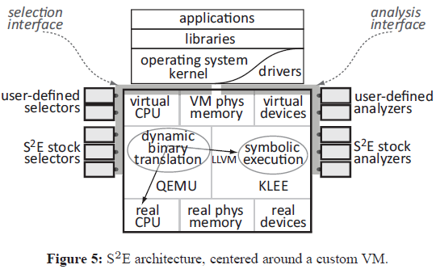
What does S²E do?
Execution consistency model
System machine instructions
Selective SE

Slide 14
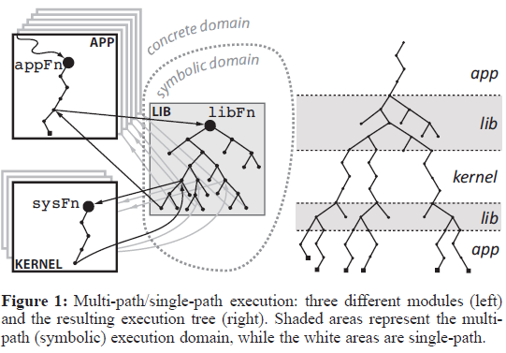
Selective SE
System
Unit
Environment
Reduce the complexity
Avoid environment modeling
Symbolic in unit
Concrete in environment
Sym dom←→Con dom
S call C
C return S
C call S
S return C

Slide 15
Selective SE
C call S:
Give constraint of input concrete → SE
Keep on the concrete → CE
S call C:
Solve constraint to get concrete → CE
Keep on the concrete → CE
over constraining
C return S:
Use x = const as constraint → SE
Keep on the concrete → CE
C return S:
Return the concrete result → CE

Slide 16
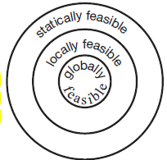
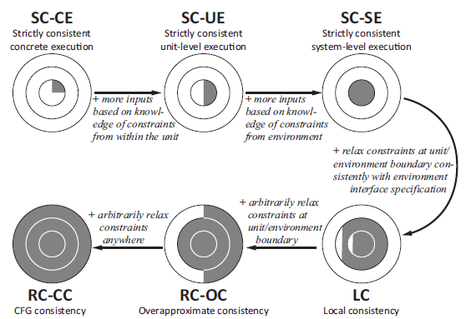
Execution Consistency Models
Path definition
Statically feasible
Locally feasible
Globally feasible
6 models
Strong to weak

Slide 17
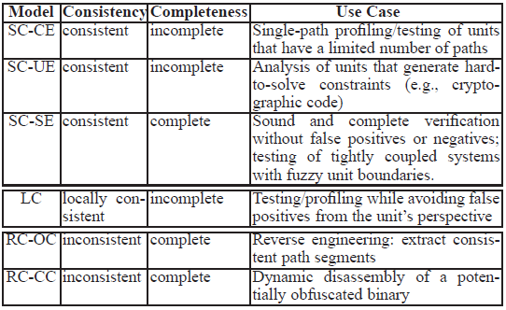
Execution Consistency Models

Slide 18
Summary
KLEE, S2E, SymbexNet
Target :
KLEE: general
S2E : large scaled real system
SymbexNet : network protocol implementation
Complexity
S2E : SE in unit, CE in environment – avoid environment modeling
SymbexNet : multi-SE, progressive, conbine SE and CE

